Slide 1

Connect-4 Reference Design
Robert R. Colvin

Slide 2
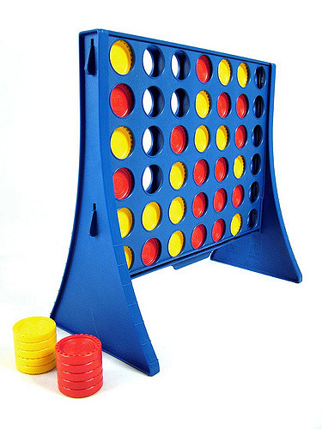
Connect-4: The Challenge
To create an (automated) game of Connect-4
https://en.wikipedia.org/wiki/Connect_Four
Initially created as a Team Building & Software Engineering task
Implemented as a Reference Design (R.D) for continued education and development purposes
Reference Design is:
Modular
Modules can be replaced or extended for each topic
Flexible
To cover the broadest topics required
Open!

Slide 3
Connect-4: Overview
Server
Client 1
Client 2
Client N
Client N+1
Server/Client architecture
At least 1x server
At least 2x clients (per server)

Slide 4
Connect-4: Basic Game Flow

Slide 5
Reference Design: Block Diagram
Data Storage
Game Logic
API Impl.
API Impl.
Board Handler
Data Storage
Client Handler
GUI
A.I
Network Handler
Network Handler
Rule Impl.
GUI

Slide 6
Sequence Diagram (Server Availability)

Slide 7
Sequence Diagram (Register Client)

